Slide 1
The Power of Asynchronous to Improve Learning
Teaching and Learning Mini-Conference 2021
Mari Borr, Professor, Teacher Education

Slide 2

Organization
Make it obvious where to start
Thoughtful placement of materials
Clear, attainable goals and objectives
Routine within modules
Standard methods of submitting assignments
Specific instructions

Slide 3

Engagement
Low-stakes assignments (form habits)
Require/reward frequent check-ins
Break large assignments into small chunks
Incorporate problem solving, active exploration, collaboration, and simulations
Use games

Slide 4

Collaboration
Asynchronous is not always independent study
Teacher-paced for discussions
Give them something valid to discuss (scenarios, videos, podcasts)
Have students complete an assignment as a group
Make their work public
Peer review
This Photo by Unknown Author is licensed under CC BY-SA-NC

Slide 5
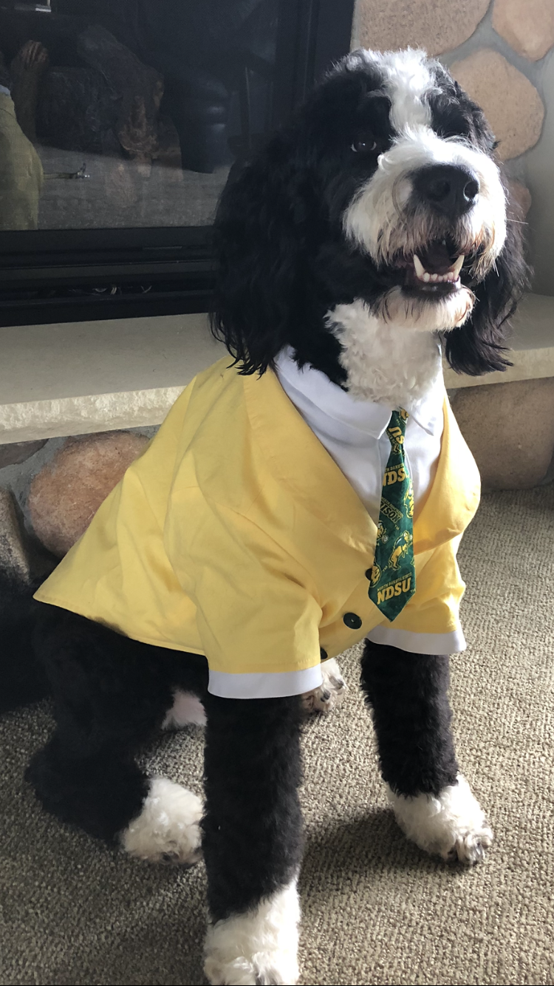
Humanize the course
Personal introductions
Share select aspects of your own life
Flexibility

Slide 6

Questions???

