Slide 1
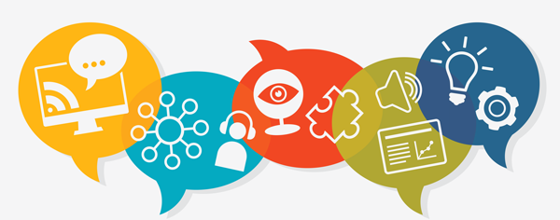
Universal Design for Learning
Teaching & Learning Mini-Virtual Conference
May 25, 2021
Lorna Olsen & Lori Swinney
Learning & Applied Innovation Center

Slide 2
Outcomes for Today
Explain what Universal Design for Learning means
Identify why it is important
Summarize how Bb Ally helps you with UDL and accessibility guidelines

Slide 3
Universal Design is …
the design and composition of an environment so that it can be
accessed,
understood, and
used to the greatest extent possible by all people regardless of their age, size, ability or disability.
Institute for Human Centered Design
Notes:
To begin with let’s look at what Universal Design means.
Any ideas? – what does it mean to you?
A group of architects, product designers, engineers and environmental design researchers got together at North Carolina State University in the 1970’s to develop a set of principles of universal design to provide guidance in the design of environments, communications, and products
Now shifting the language to Inclusive Design for people across the spectrum of ability, age, culture, and socio-economic status. We were motivated to shift language for these reasons
https://www.humancentereddesign.org/index.php/inclusive-design/history
“the design of products, environments and communication to be usable by all people, to the greatest extend possible, without adaptation or specialized design” (Institute for Human Centered Design, 2016)

Slide 4

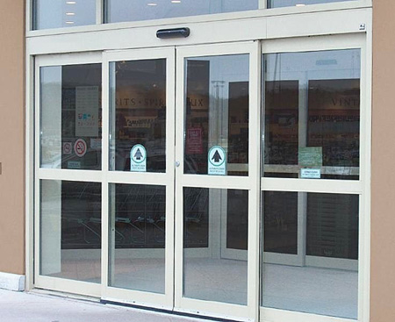

Universal Design Example
Source: Why we need Universal Design
TEDx Talk talking about Universal Design and why it is important
Notes:
Other examples include curb cutouts, closed captioning on TV

Slide 5
Universal Design for Learning is
provides all students with an equal opportunity to learn,
designed in flexible ways to meet the needs of individual learners, and
prepared with flexible means, methods, and materials to better meet the needs of every student.
Notes:
Now let’s add LEARNING into Universal Design
When you think about universal design in an education setting, we apply the same principles to
curriculum,
teaching strategies and
how students learn brings together UDL and UD for Instruction, which recognizes the need to change teaching strategies to reach the Learners
Thomas Tobin – Reach Everyone, Teach Everyone

Slide 6

What is UDL?

Slide 7
How Humans Learn
UDL Guidelines
CAST
Notes:
Research suggests that learning involves three specific areas of our brains, and that there is not only one way to learn. The Center for Applied Special Technologies (CAST), using neuroscience research, developed a framework, with UDL guidelines
Why - engagement
What – how the resources and materials are represented
How – what is the action (activity) of the students and how can they express their understanding and knowledge

Slide 8

They all Work Together
Affective networks
(the why)
Strategic
networks
(the how)
Recognition networks
(the what)
Notes:
Research suggests that learning involves three specific areas of our brains, and that there is not only one way to learn. The Center for Applied Special Technologies (CAST), using neuroscience research, developed a framework, with UDL guidelines
How – what is the action (activity) of the students and how can they express their understanding and knowledge
Why - engagement
What – how the resources and materials are represented
They all work together

Slide 9
The Why: Engagement
Choice & autonomy (but not too much)
Provide students with options on how to engage in course activities
Align goals & objectives for relevance & value

Slide 10
The What: Representation
Variety of ways to display and provide information
Connect to previous knowledge for improved understanding
Illustrate through multiple means

Slide 11
The How: Action & Expression
Students choose from among ways to demonstrate what they have learned
Flexibility in some deadlines
Provide multiple opportunities for strategy development and feedback

Slide 12
Example: UDL Assignment
Describe various types of learning
Options
  Poster
  Research Report
  Presentation
  Video/computer simulation
Due date fixed, drafts flexible
Notes:
Several examples of assignments using UDL strategies

Slide 13
Example: UDL Content
Provide multiple formats of information
Captions on videos
Provide audio only options without visual distractions

Slide 14
A Quick Review…
Provide:
Multiple means of engagement
Multiple means of representation
Multiple means of expression

Slide 15
Making Simple Changes
  Blackboard Ally
    Alternative Formats for students
    Guidance for Instructors to improve accessibility
  Where to start
    Syllabus
    Textbook, required readings
    Videos captioned
  Video Captioning
Notes:
Ally enabled for all NDSU Blackboard courses in December, 2020
Ally helps both instructors and learners in two different ways
YuJa, YouTube both do auto-captioning – best practice: review the auto-captions and edit as needed. Both YuJa and YouTube allow captions to be edited relatively easily – Ally does NOT check videos for accessibility!
Both YuJa and YouTube allow you to upload caption files for better accuracy

Slide 16
Instructor View
Notes:
Hover over a gear icon to see Low, Medium, High, Perfect
Students will NOT see the “gear icons” but they will see the Alternative format download icons on MOST, but not all content – Excel is an excellent example – not currently checked by Ally

Slide 17
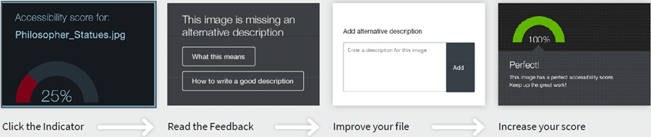
Instructor View with Guidance
Notes:
Click a gear icon to open the instructor feedback panel – see the accessibility percentage score, guidance, and learn how to increase the accessibility score
Goal: all content scored as perfect; however, this doesn’t mean you have to get everything scored to 100% immediately – it’s a work in progress!
To start make sure the course syllabus is as accessible as possible and make sure required digital textbooks and required readings are accessible. All video and audio recordings should be captioned.

Slide 18
Student View
Notes:
Alternative formats are automatically created when learners click the alternative format icon and select a format. Formats available depend on the type of file selected. Alternative formats give learners the choice – can be used by any learner – not just those with disabilities! Example: Audio – MP3 version while traveling or HTML to read document on a small cell phone screen!

Slide 19
Resources
Center for Applied Special Technology (CAST) Universal Design for Learning Guidelines
Universally Designed Assignments
UDL and Accessibility @NDSU
OTL Universal Design
Blackboard Help Ally for Blackboard

